Slide 2
CompliSign
For the Operator Admin User

Slide 3
Operator Admin functions
Operator Admins can:
View, edit and add Patients, Technicians, Physicians and Facilities
View and edit existing orders
Make new orders and schedule technicians
View and edit schedule
View physician letters
Create and view custom Reports
View activity

Slide 4
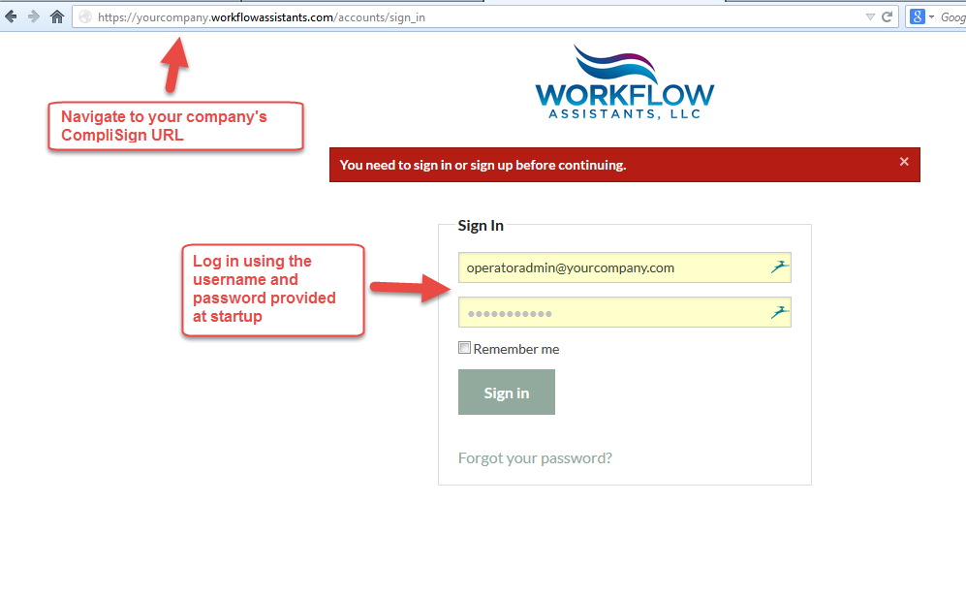
Logging in

Slide 5
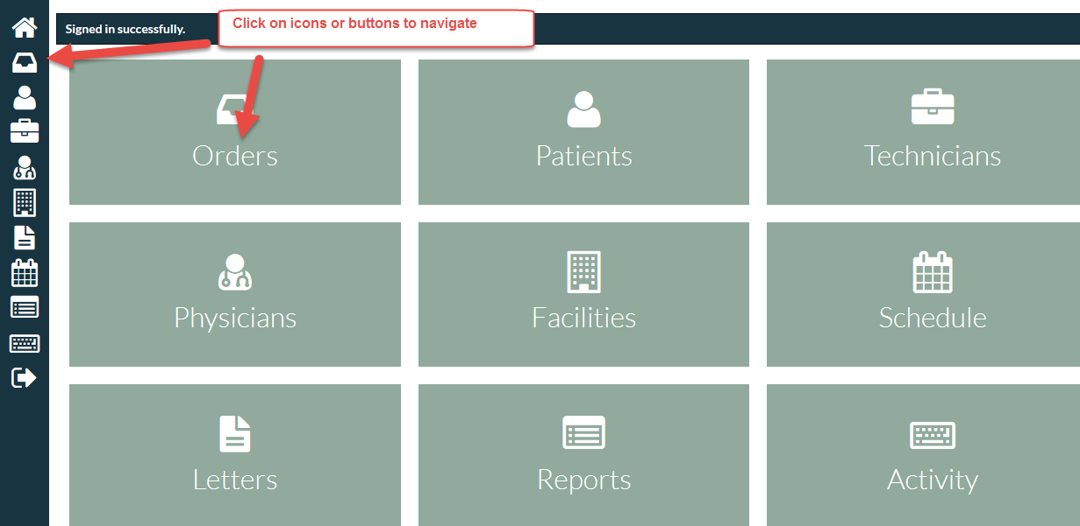
Dashboard

Slide 6
Orders

Slide 7
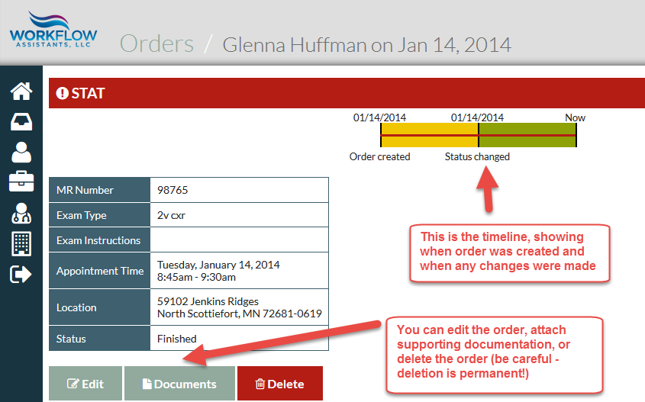
Viewing and Editing an Order

Slide 8
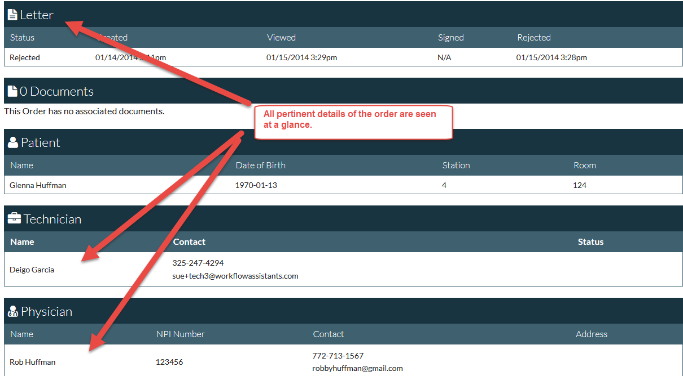
Order Details

Slide 9
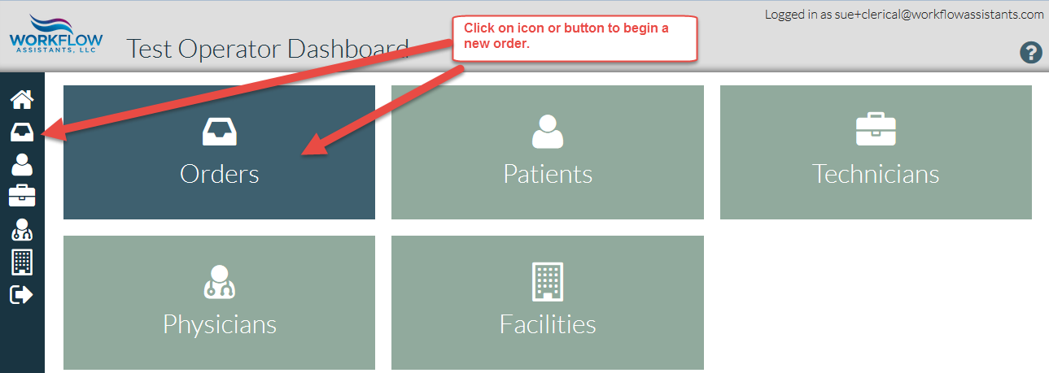
Making a new order

Slide 10
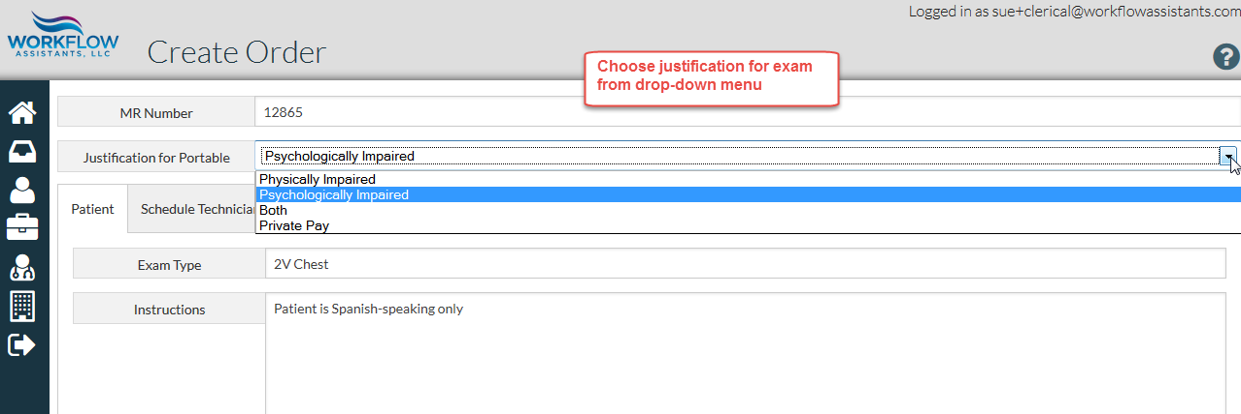
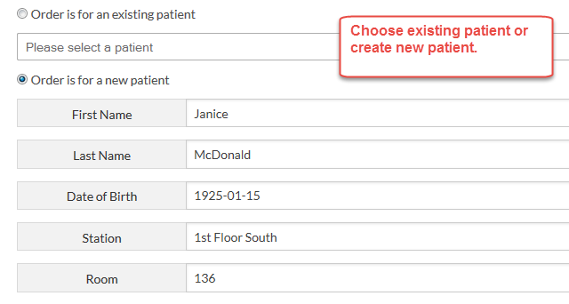
Adding Order Information
Patient, exam and facility

Slide 11
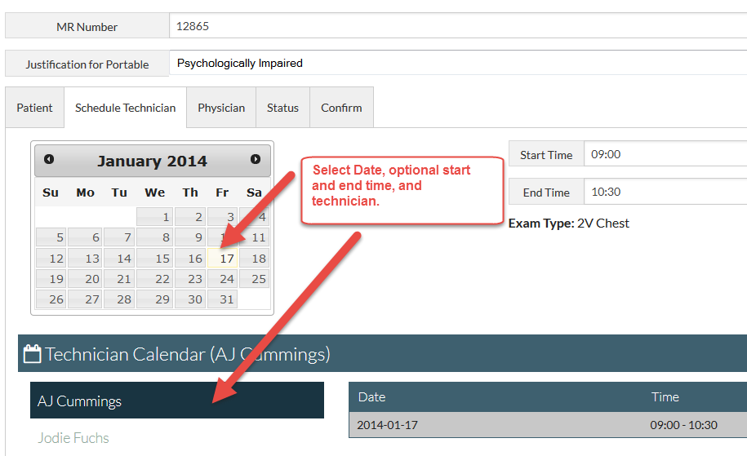
Schedule exam

Slide 12
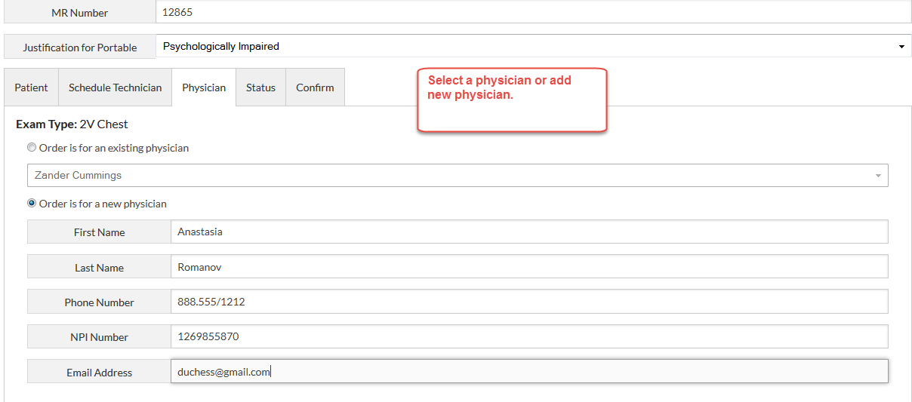
Assign to Physician

Slide 13
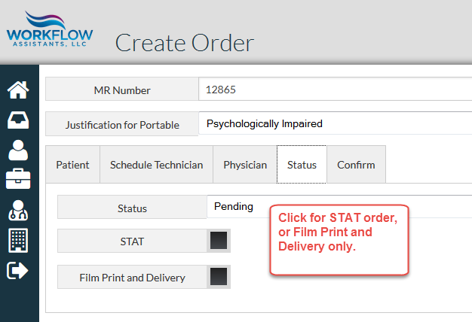
Select Status

Slide 14
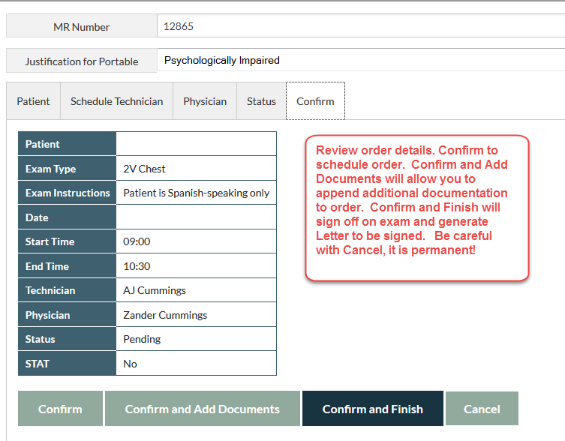
Confirm Order

Slide 15
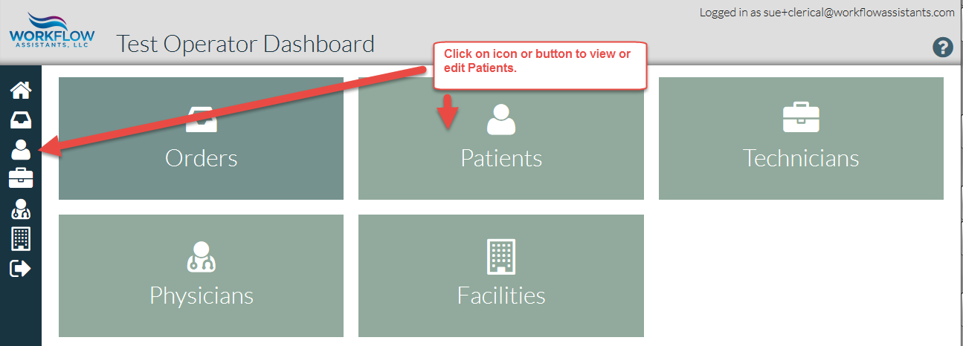
Patients

Slide 16
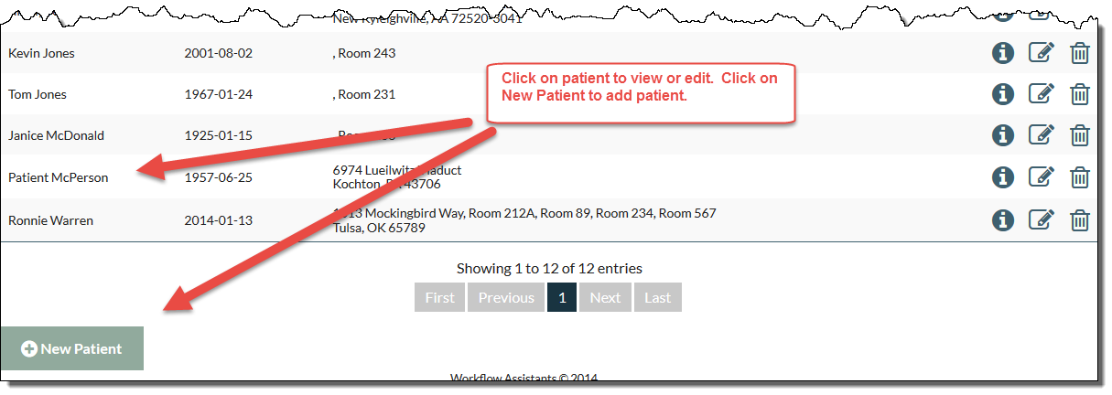
Adding or editing patient

Slide 17
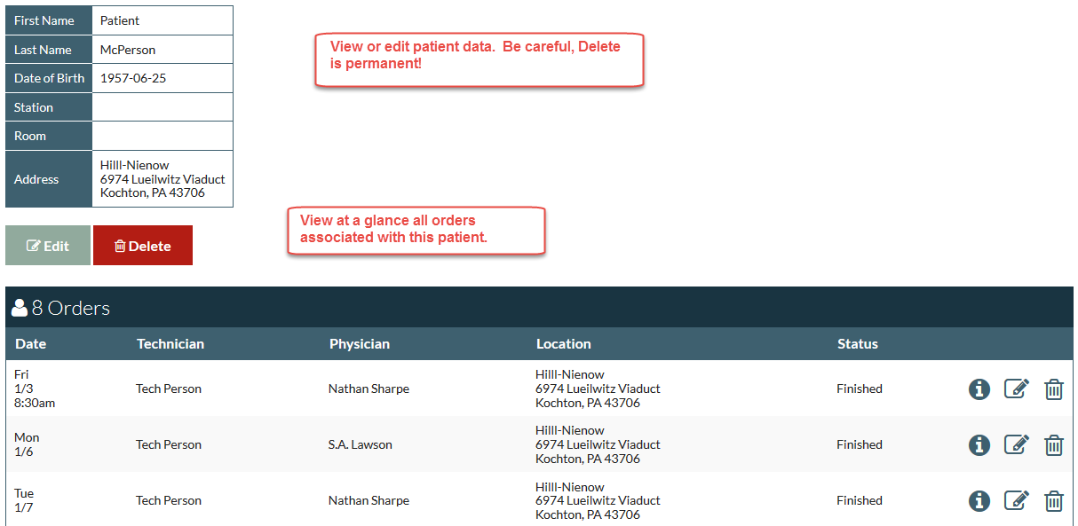
Patient data at a glance

Slide 18
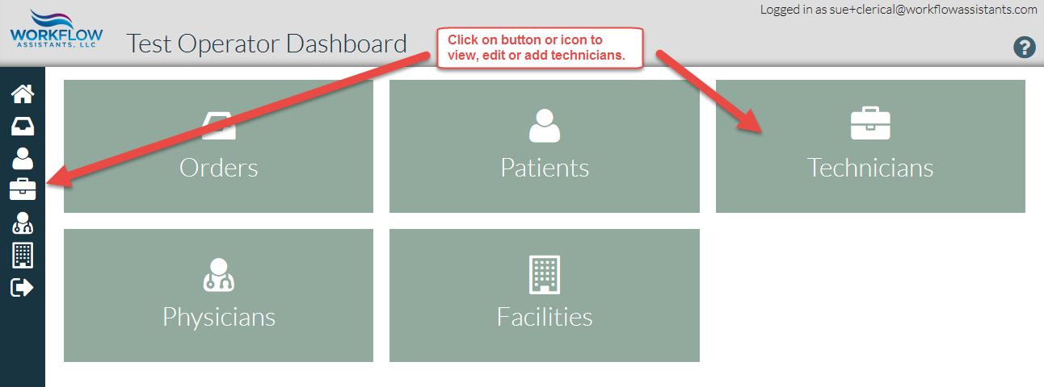
Technicians

Slide 19
Adding or editing technician

Slide 20
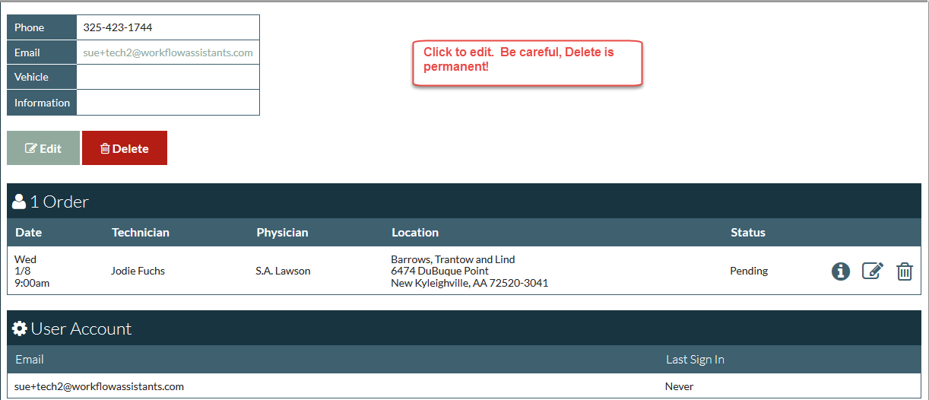
Technician data at a glance

Slide 21
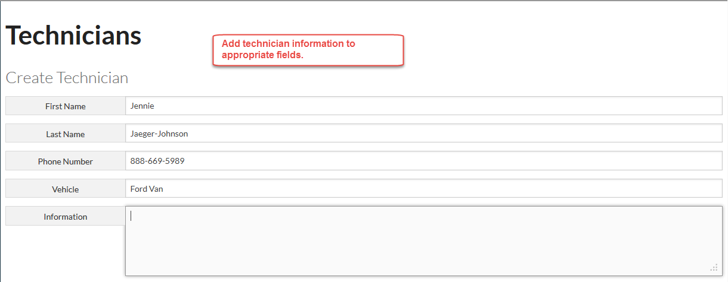
Adding a technician

Slide 22
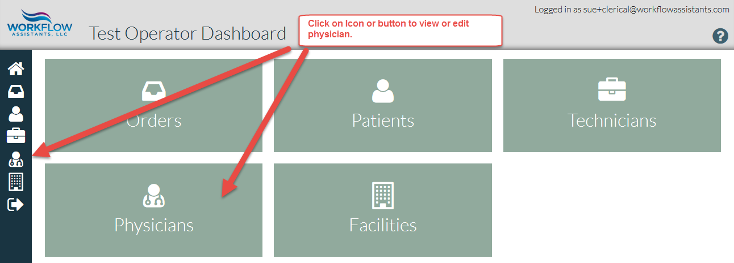
Physicians

Slide 23
Viewing, adding or editing a physician

Slide 24
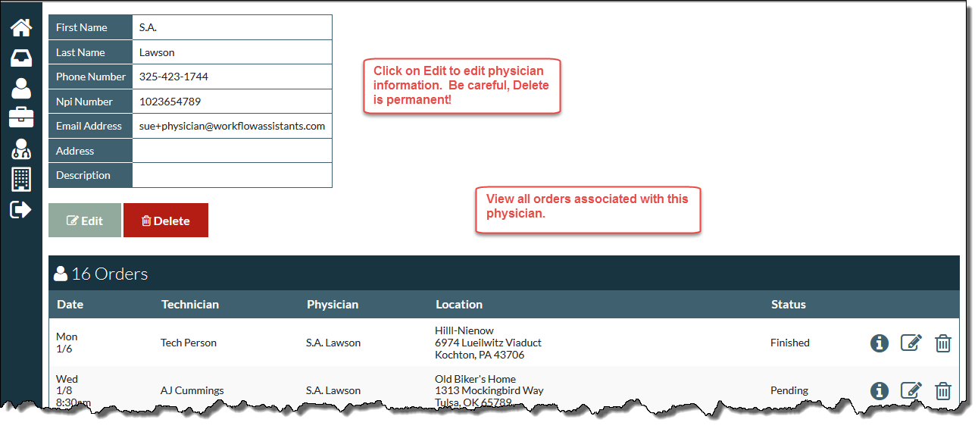
Physician data at a glance

Slide 25
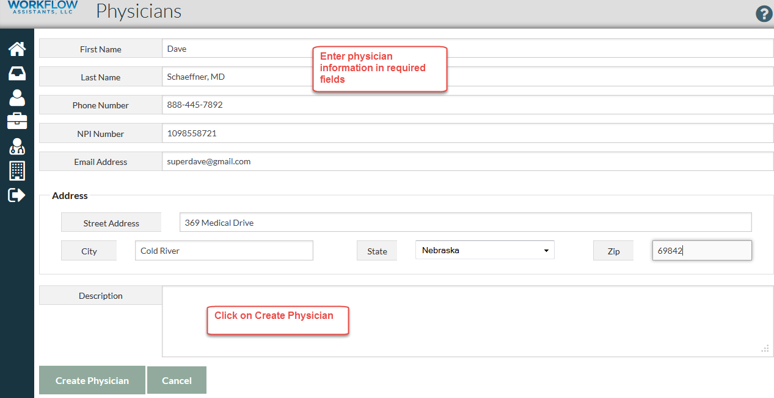
Adding a physician

Slide 26
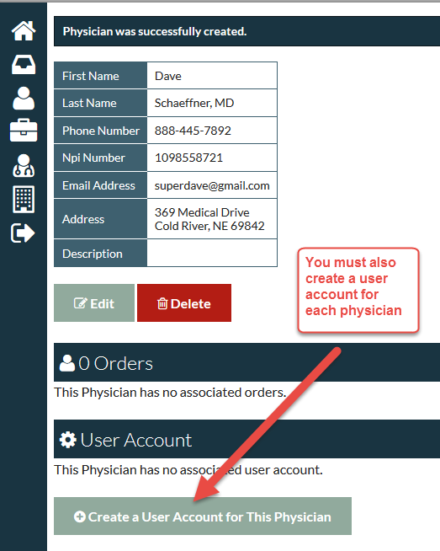
Creating User Account

Slide 27
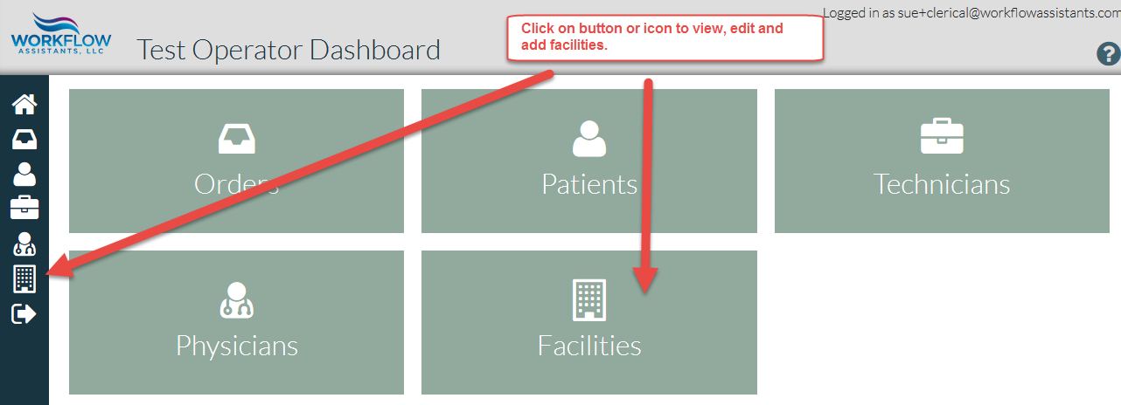
Facilities

Slide 28
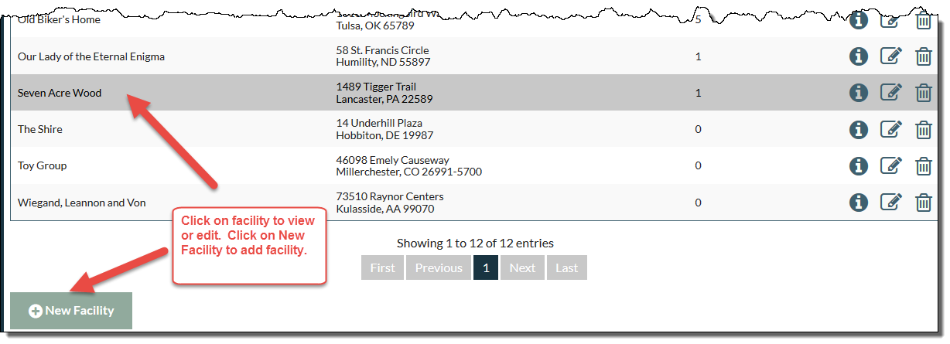
Viewing, editing or adding a facility

Slide 29
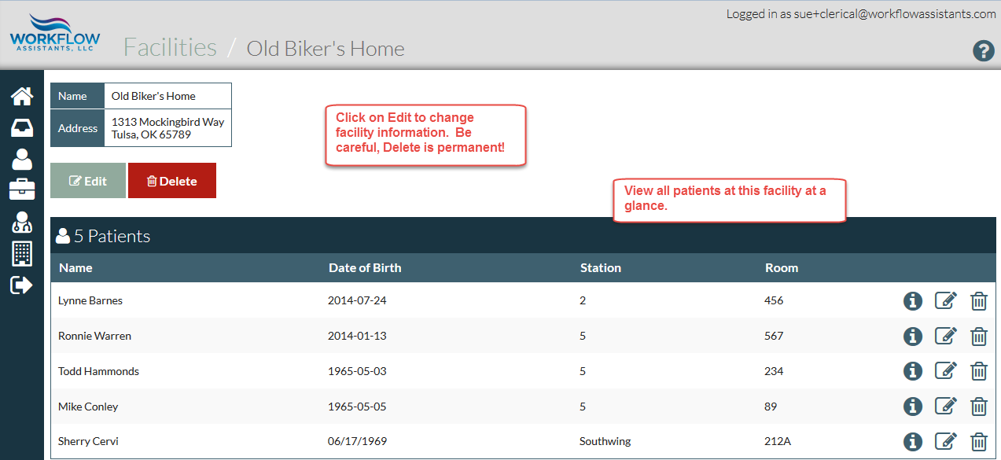
Facility data at a glance

Slide 30
Adding a facility

Slide 31
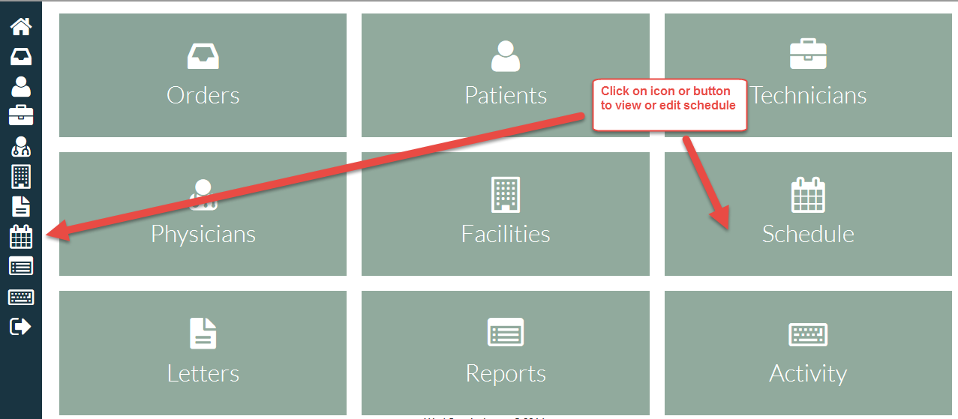
Schedule

Slide 32
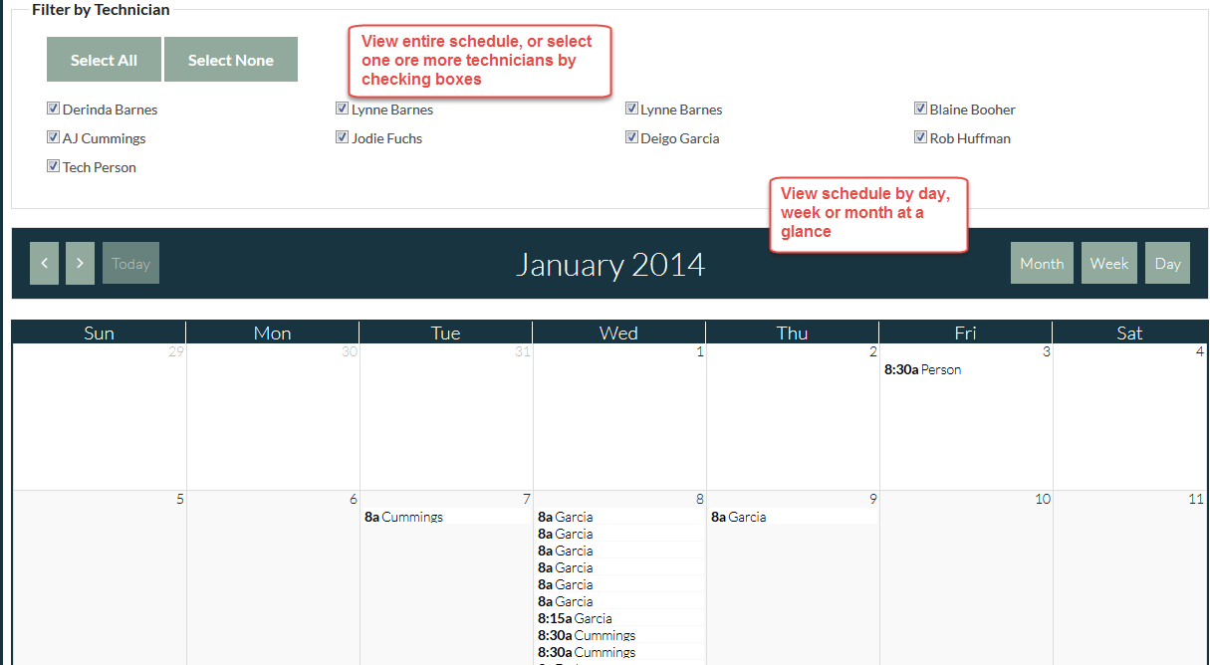
Viewing schedule

Slide 33
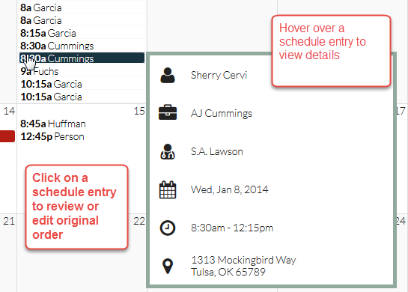
Schedule details

Slide 34
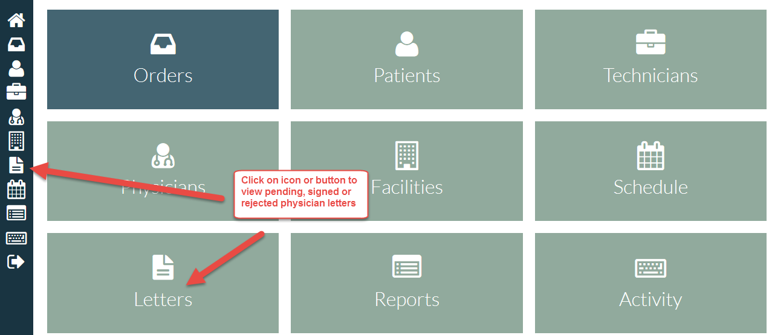
Letters

Slide 35
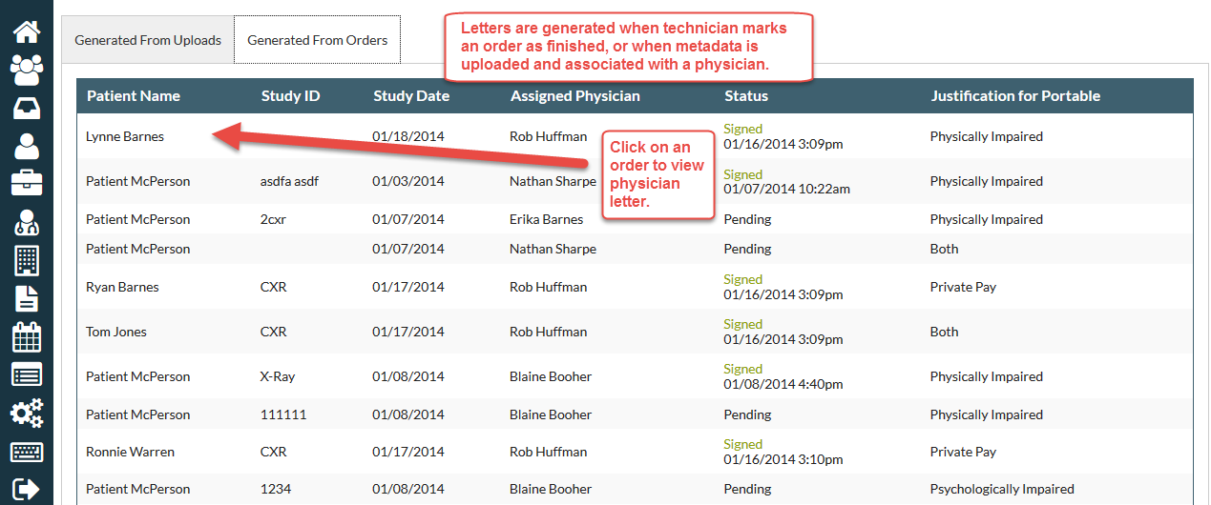
Viewing letters

Slide 36
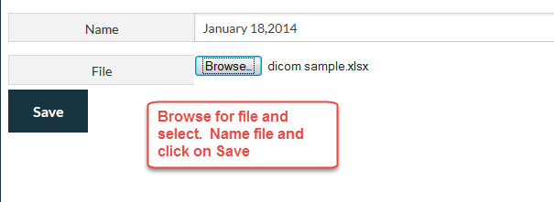
Generating letters from uploads

Slide 37
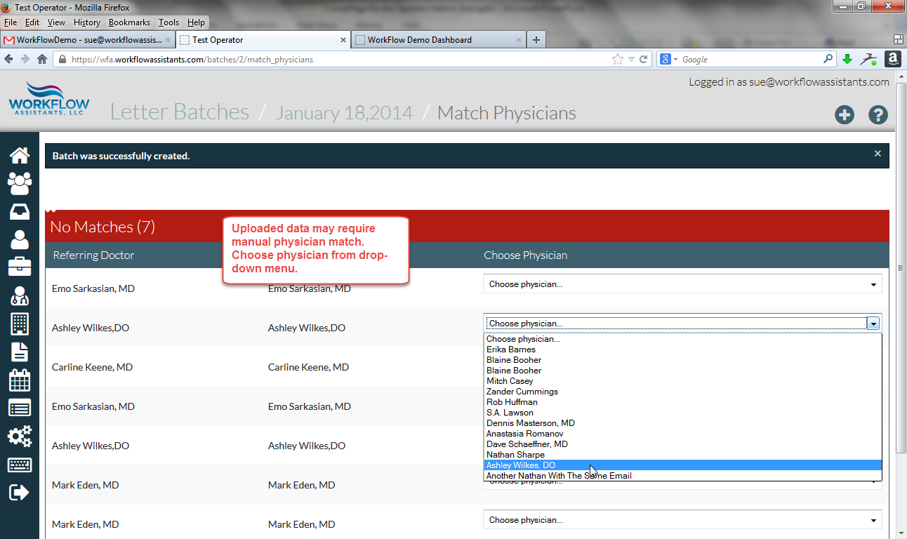
Matching physician

Slide 38
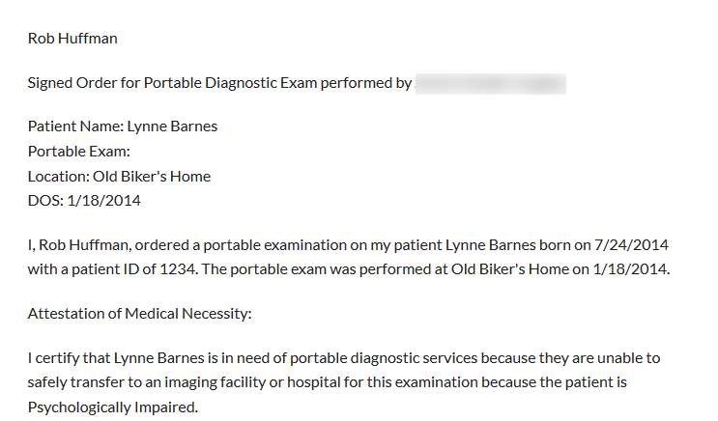
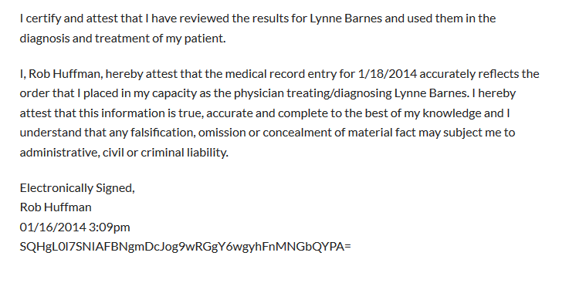
Viewing letter

Slide 39
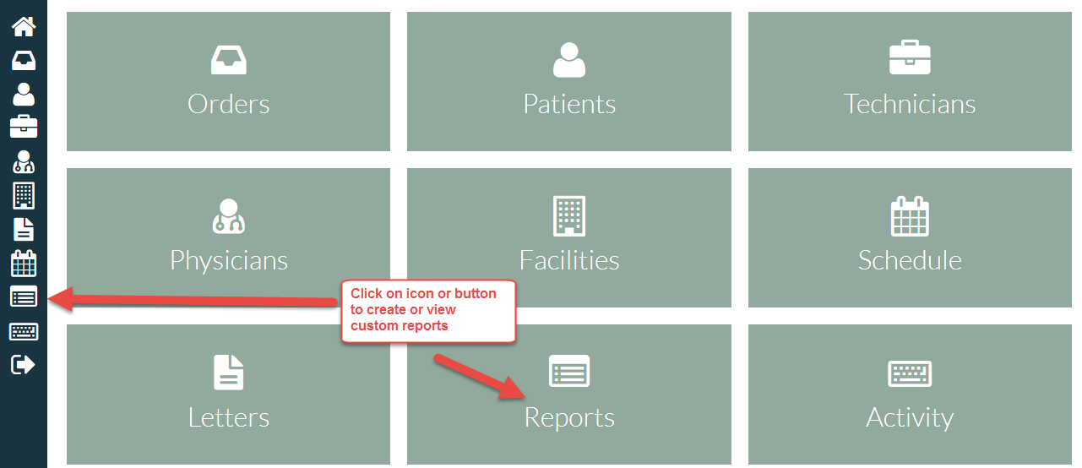
Reports

Slide 40
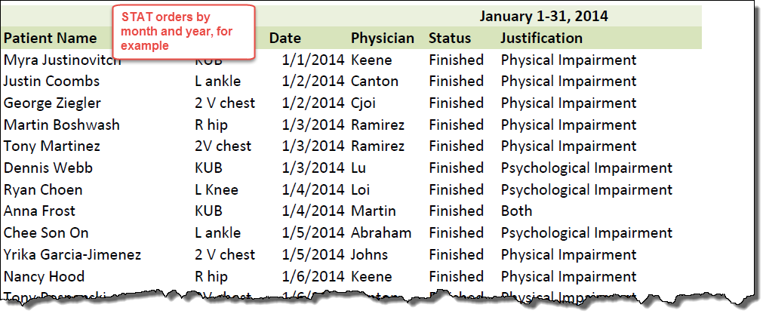
Custom report

Slide 41
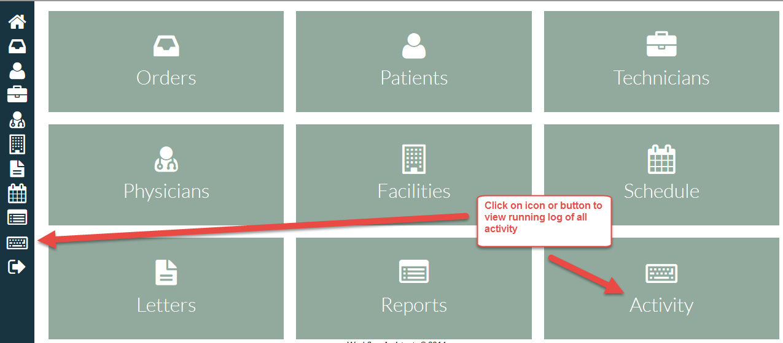
Activity

Slide 42
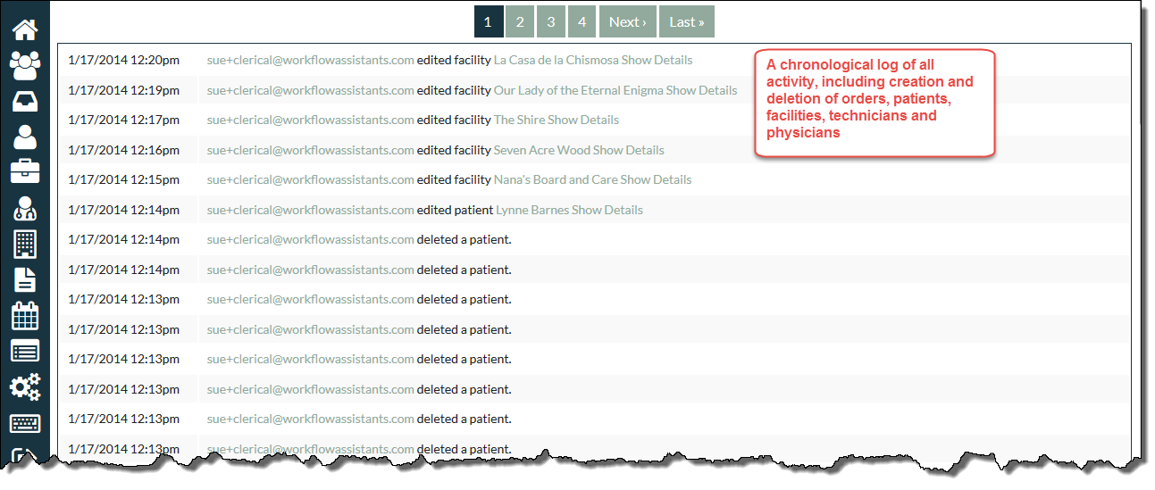
Viewing activity

Slide 43
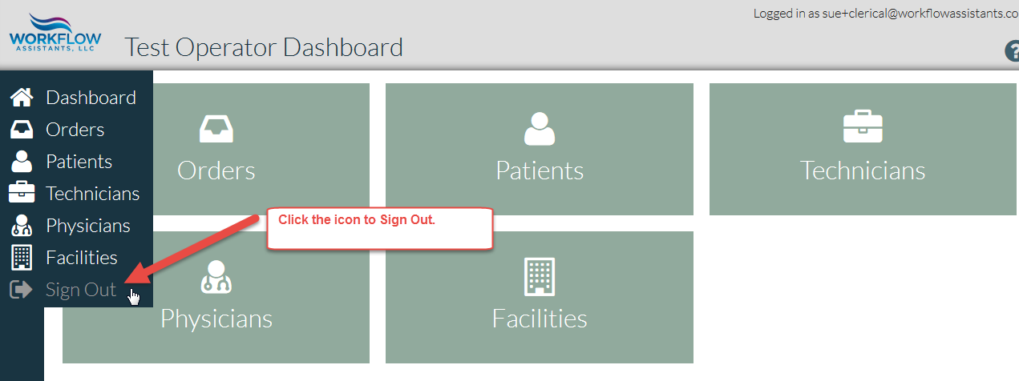
Signing Out

Slide 44
Recap
Operator Admins can:
View, edit and add Patients, Technicians, Physicians and Facilities
View and edit existing orders
Make new orders and schedule technicians
View and edit schedule
View physician letters
Create and view custom Reports
View activity

Slide 45
Thank you for viewing CompliSign for the Operator Admin

